Slide 1




Super Store Sales Analysis
Report
Supervisor: Mahmoud Khorshid

Slide 2

Our Team
Adel
Ahmed S.
Ezz A.
Ahmed M.
Ahmed

Slide 3

agenda
Introduction
Data overview
EDA & Feature engineering
visualization & insights
Recommendations
modeling

Slide 4


Introduction
In this project, we focused on building a sales forecasting model by following key steps in the machine learning workflow. We started with data preprocessing using libraries like NumPy and Pandas, followed by developing the predictive model using machine learning libraries such as Scikit-learn and XGBoost. We also created a dashboard using Dash and included interactive visualizations within the Jupyter Notebook using Matplotlib and Seaborn. Finally, we deployed the model using Streamlit, providing an interactive web app to help users generate sales forecasts and make data-driven decisions for marketing and inventory planning.

Slide 5
Dataset Overview
This dataset contains sales records from a global store, including information about orders, customers, products, shipping, and financial metrics. It is commonly used for sales analysis and forecasting tasks.
Number of records: 9,994
Number of features: 21
Time range: 2014 to 2017
Geography: United States (across different regions, states, and cities)

Slide 6
Data dictionary
Order ID | Unique identifier for each order
Order Date | Date when the order was placed
Ship Date | Date when the order was shipped
Ship Mode | Shipping method used (e.g., First Class, Standard Class)

Slide 7
Data dictionary
Customer ID | Unique identifier for each customer
Customer Name | Full name of the customer
Segment | Customer segment (Consumer, Corporate, Home Office)
Country | Country name (all entries are United States)

Slide 8
Data dictionary
City | City Name
State | State Name
Postal Code | Zip Code
Region | Sales region (e.g., East, West)

Slide 9
Data dictionary
Product ID | Unique product identifier
Category | Product category (Furniture, Office Supplies, Technology)
Sub-Category | Detailed product sub-category (e.g., Chairs, Binders)
Product Name | Full name of the product

Slide 10
Data dictionary
Sales | Sales amount in USD
Quantity | Number of units sold
Discount | Discount applied on the sale
Profit | Profit earned from the sale

Slide 11
Exploratory Data Analysis (EDA)

Slide 12
Problems
Nulls ?
Duplicates?
No Null Values
Yes, 1 Row

Slide 13
Problems
Outliers?
DataType?
Yes
Sales Column : 1167
Profits Column : 1881
Order Date : Convert to Datetime
Object Columns → Categorical

Slide 14
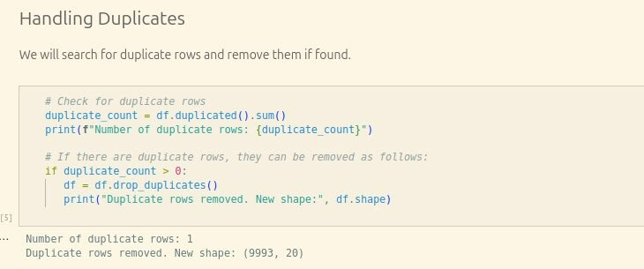
Handle Duplicated

Slide 15
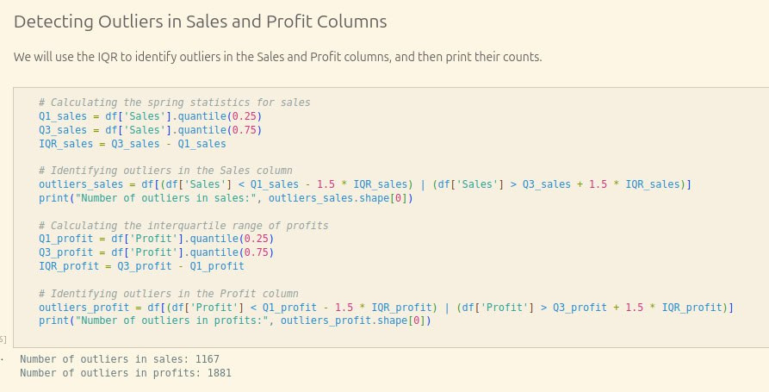
Handle Outliers

Slide 16
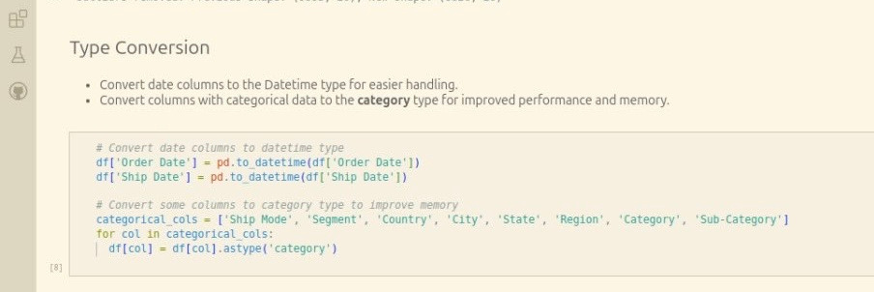
Handle DataType

Slide 17
Feature Engineering

Slide 18
1. Aggregating Data by Day
We group the data by ‘Order Date’ to calculate daily metrics that are important for time-series forecasting. Specifically, we compute:
Total Sales (sum)
Total Profit (sum)
Total Quantity Sold (sum)
Average Discount (mean)
This gives us a daily-level view of the business performance.

Slide 19
2. Extracting Date Features
To enhance the predictive power of time-series models, we extract several features from the ‘Order Date’ column:
Year: The year of the order
Month: The month number (1–12)
Quarter: The quarter of the year (1–4)
Day: The day of the month
DayOfWeek: Day of the week (0 = Monday, 6 = Sunday)
DayOfYear: Ordinal day of the year (1–365/366)
WeekOfYear: ISO week number of the year

Slide 20
3. Lag Features and Feature Engineering for Time-Series Forecasting
Create Lag and Rolling Features
To help the model understand time-based patterns, we add:
lag_1: Sales value from the previous day
lag_7: Sales value from 7 days ago
roll_mean_7: 7-day rolling average of sales, shifted by one day to avoid data leakage

Slide 21
4. Drop Missing Values and Save Cleaned Data
When we create lag and rolling average features, the first few rows will have missing values (NaN) because there is no previous data to refer to.
We remove these rows to make the data clean and ready for modeling.
After that, we save the cleaned dataset to a new CSV file called cleaned_superstore.csv.

Slide 22
Result
We saved data as a (cleaned_superstore) to be used in modeling:
here

Slide 23
Sales and data insights

Slide 24

Which cities generate the highest revenue?
1

Slide 25
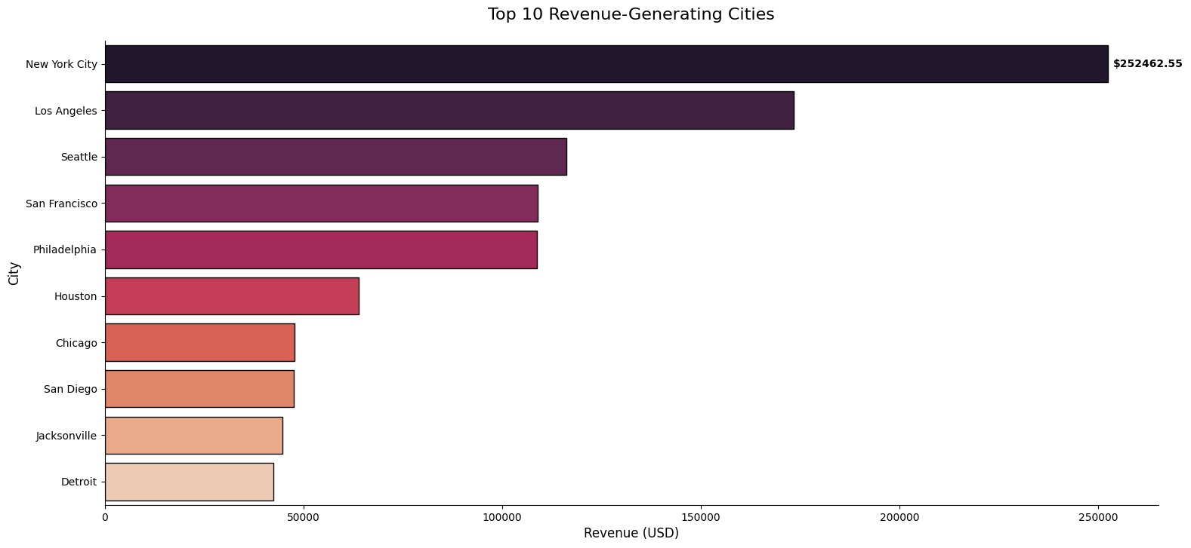
"As we can see, New York City is clearly outperforming all other cities, generating over $250K in revenue. This raises key questions about market potential and how to replicate this success elsewhere."

Slide 26
Which states are leading in revenue performance?
2

Slide 27
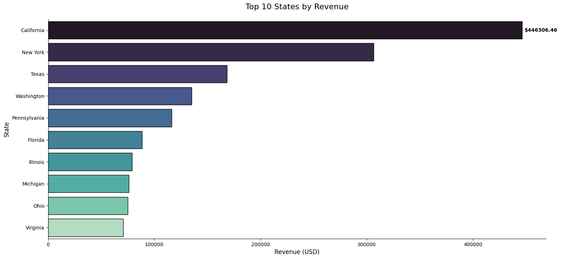
“California and New York lead in revenue, showing strong regional concentration.
We need to assess if our operations and marketing align with these key states.”

Slide 28
Which product categories are generating the most revenue?
3

Slide 29
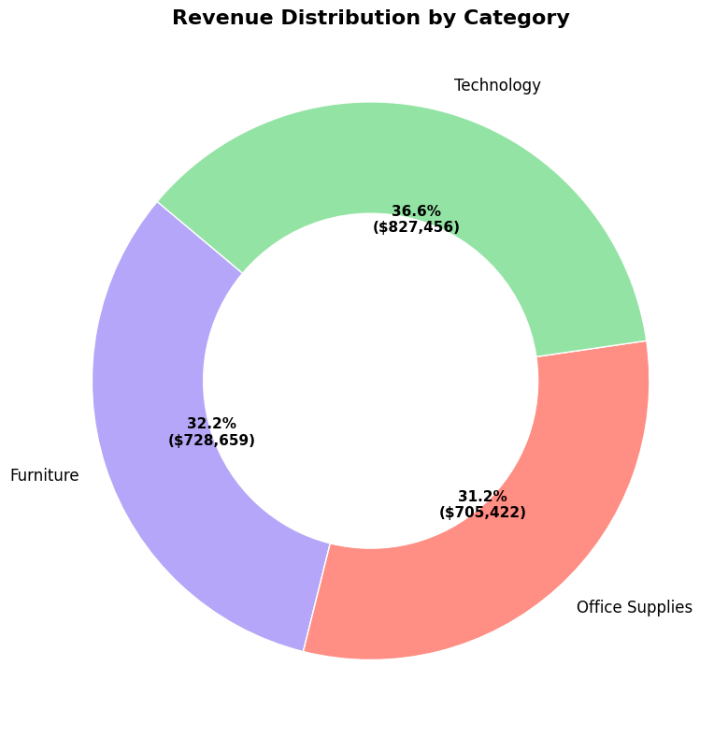
“Technology leads revenue share, but Furniture and Office Supplies follow closely.
All three categories are relatively balanced, suggesting a diverse product performance.”

Slide 30
Which products are contributing the most to overall revenue?
Is there a clear top performer?
4

Slide 31
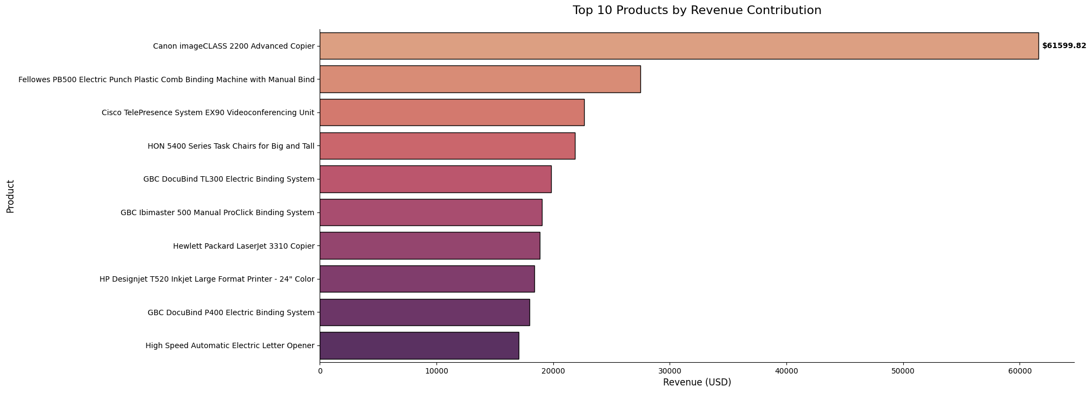
Canon imageCLASS 2200 stands out as the top revenue generator, significantly outperforming other products.
The remaining items show relatively balanced contributions, indicating revenue diversification across multiple products.

Slide 32
Which sub-categories are generating the highest revenue overall?
5

Slide 33

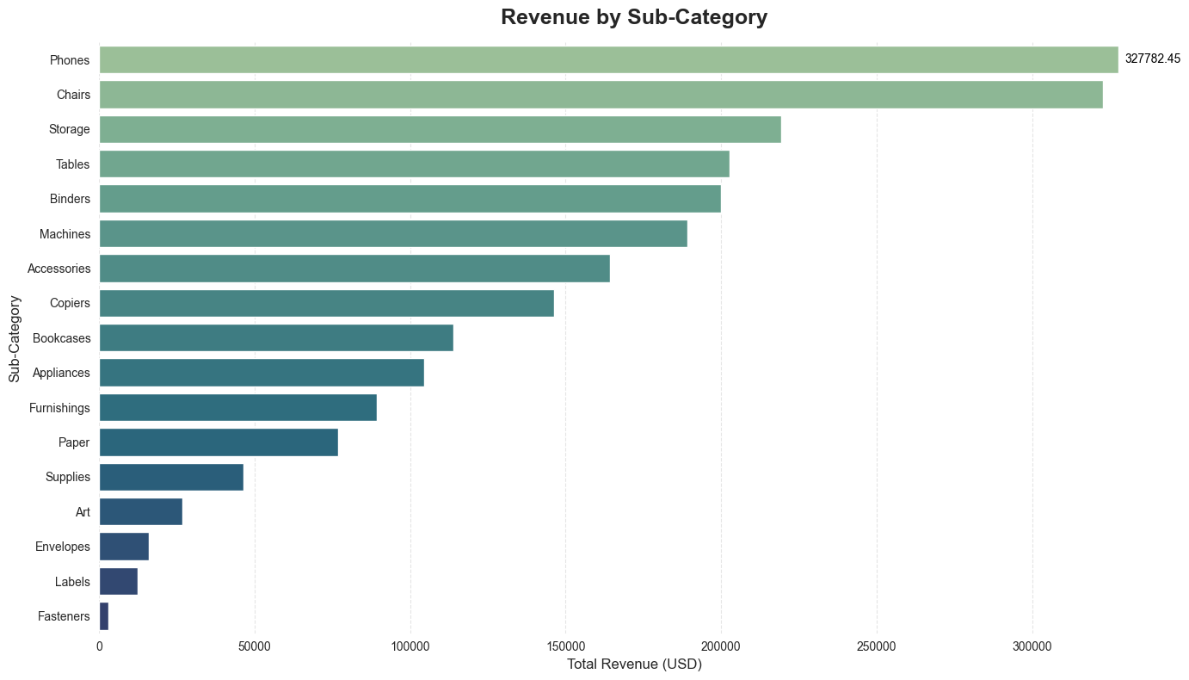

Phones and Chairs are the leading sub-categories by revenue, followed by Storage and Tables.
These trends can guide decisions around inventory prioritization and marketing focus.

Slide 34
Which customer segments contribute the most to revenue?
7

Slide 35
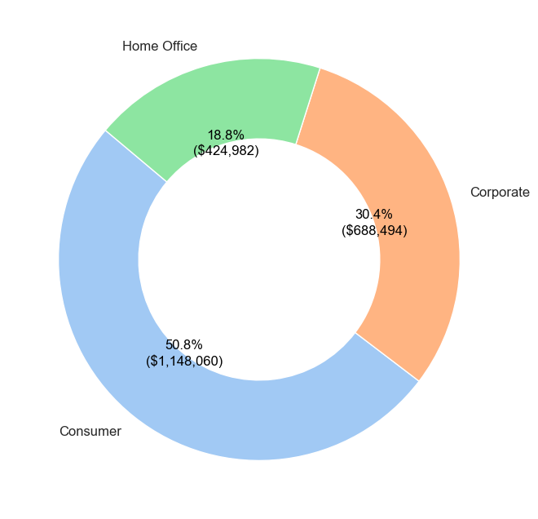
Consumer segment dominates, followed by Corporate. Home Office contributes the least.

Slide 36
Which states and regions generate the highest revenue?
6

Slide 37
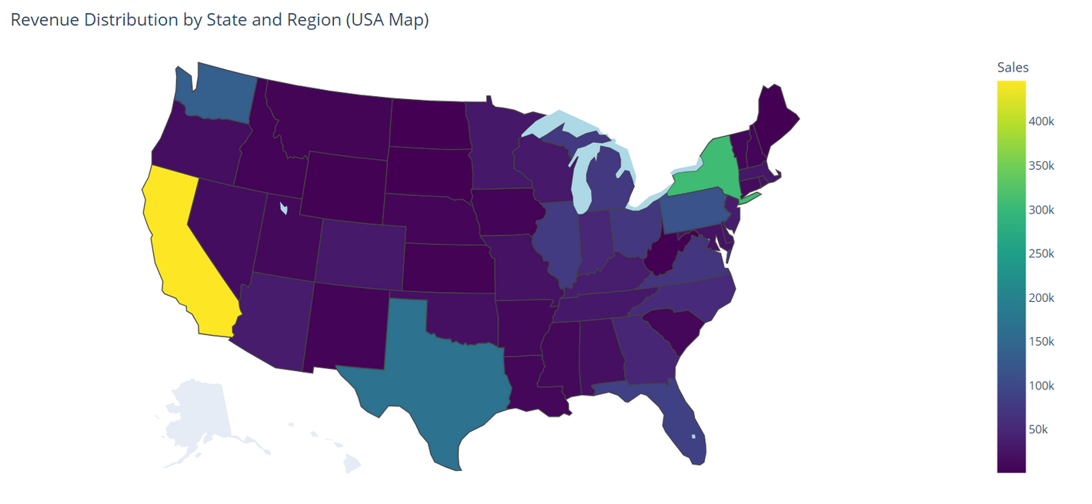
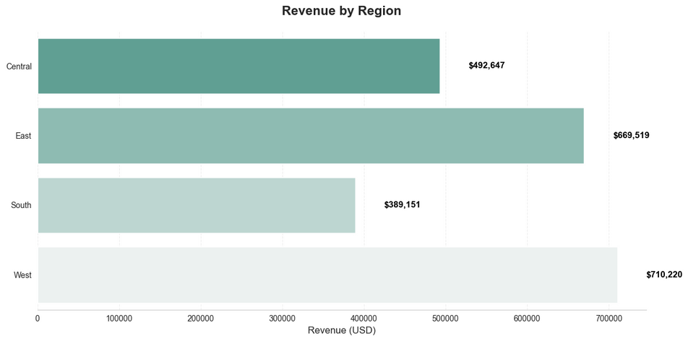
California leads in sales, followed by Texas and New York.
The West and East regions show strong performance overall.

Slide 38
How do sales trend over the months?
8

Slide 39
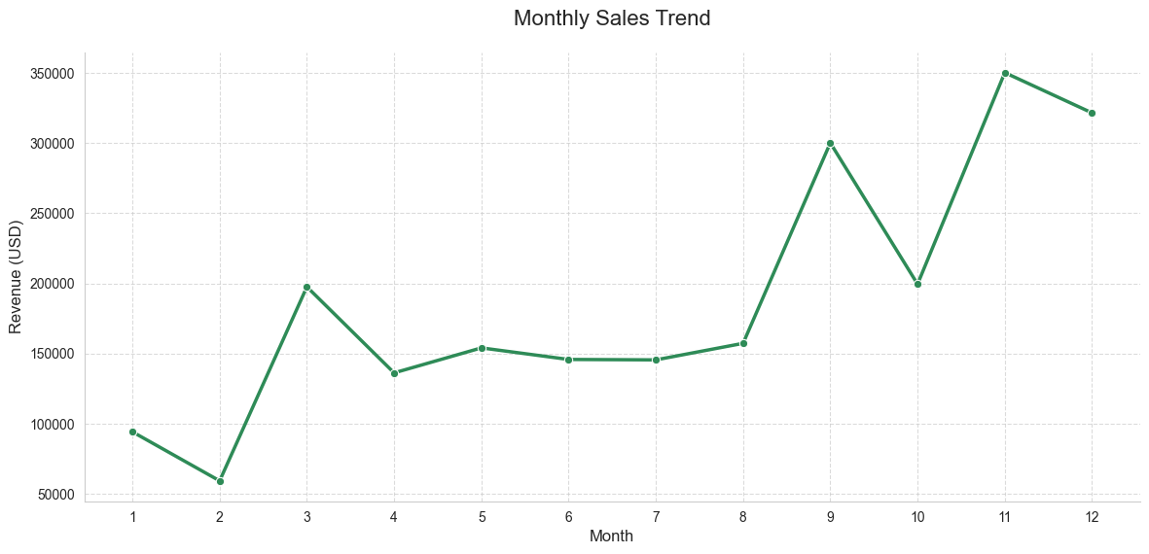
Sales start around $130K in January.
Peaks in October ($320K) and November ($360K).
The second half of the year shows consistent growth in revenue.

Slide 40
How long do customers usually wait for their orders?
9

Slide 41
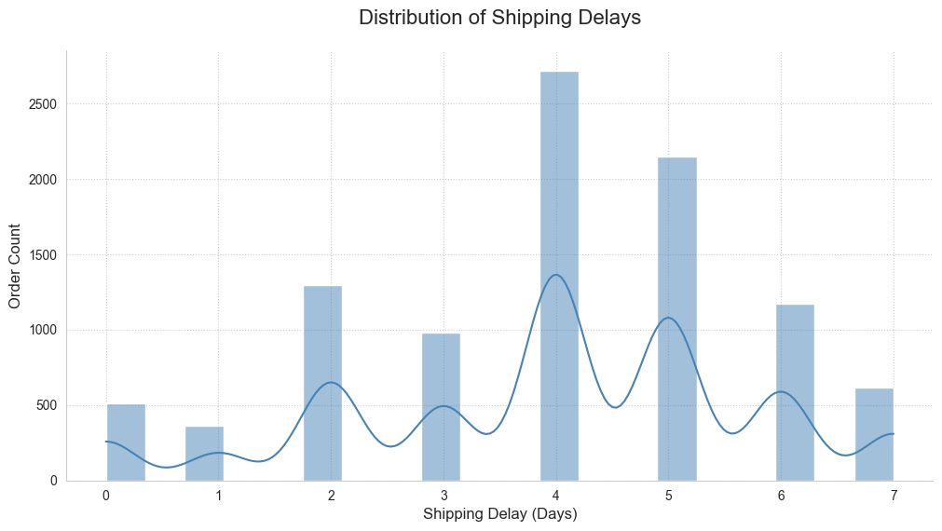
Most delays happen on Thursday and Friday, with over 2,700 orders delayed on Thursday and more than 2,100 on Friday.
Delays earlier in the week, like Monday and Tuesday, are much lower, with fewer than 1,300 orders combined.

Slide 42
recommendation
Focus marketing on top-selling products, keep them in stock, and analyze who buys them to target those customers better.
Spend more marketing budget on the West, Central, California, and New York regions, since they perform the best.
Technology products sell the most, followed by office supplies and furniture. Binders and paper are top subcategories. Focus on these items in your inventory and marketing to boost sales.

Slide 43
recommendation
4. Consumers make the most purchases, followed by Corporate and Home Office. Standard shipping is the most used, so focusing on it especially for large orders can improve efficiency and meet customer needs.
5. Sales generally increase over time, but drop during certain months due to reasons like shipping delays, holidays, pricing, and customer locations.

Slide 44
Customer Satisfaction
customers in the Technology category receive their products faster,
it may indicate that they prioritize speed in delivery.
This can enhance customer satisfaction and repeat business.

Slide 45
Marketing Strategy
You can tailor marketing messages for different categories.
For instance, if Technology is perceived as a faster delivery
category, you might highlight that in promotions.

Slide 46
Operational Efficiency
Knowing that Technology items are shipped faster,
you may want to analyze your shipping processes
for Furniture and Office Supplies to identify areas for improvement,
such as optimizing logistics, packaging, or warehousing.

Slide 47
Inventory Management
Technology products are in higher demand and require quicker shipping,
you may need to ensure that inventory levels are sufficient to meet that demand promptly.

Slide 48
Modling

Slide 49
Define Features
Time
Sales
Lag & Rolling
Year, Month, Quarter, Day, DayOfWeek, DayOfYear, WeekOfYear
Profit
Quantity
Discount
lag_1
lag_7
roll_mean_7

Slide 50
Split
Feature
Target
Year, Month, Quarter, Day, DayOfWeek, DayOfYear, WeekOfYear
Sales

Slide 51
Train & Test split
Splitdata based on date
“2022-01-01”

Slide 52
train 4 models
We trained and evaluated four machine learning models:
Linear Regeneration → A simple and interpretable baseline
Decision Tree Regressor → A non-linear model that can capture more complex patterns
Random Forest Regressor → An ensemble method that improves robustness and accuracy
XGBoost Regressor → A powerful gradient boosting model optmized for performance
Each model was trained on the same dataset after preprocessing, and evaluated based on performance metrics like accuracy, precision, recall, F1-score, and ROC-AUC.

Slide 53
Evaluation Metrics
To evaluate the models, we used:
MAE
RMSE
Recall
MAPE
R2 Score
These metrics help us understand not just how many predictions are correct, but how good the predictions are.

Slide 54
Hyperparameter Tuning
Optimizing Model Performance
We applied GridSearchCV to improve performance by tuning key hyperparameters:
Cross-validation was used to avoid overfitting during the tuning process.
Best parameters were selected based on performance metrics
Each model was trained on the same dataset after preprocessing, and evaluated based on performance metrics

Slide 55
Why XGBoost Wins ?

Slide 56
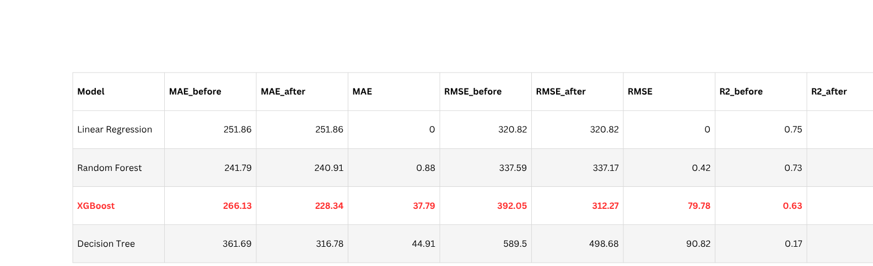
Best Overall Performance:
XGBoost consistently achieved the highest scores across all key evaluation metrics (Accuracy, F1-score, ROC-AUC), both before and after hyperparameter tuning.

Slide 57
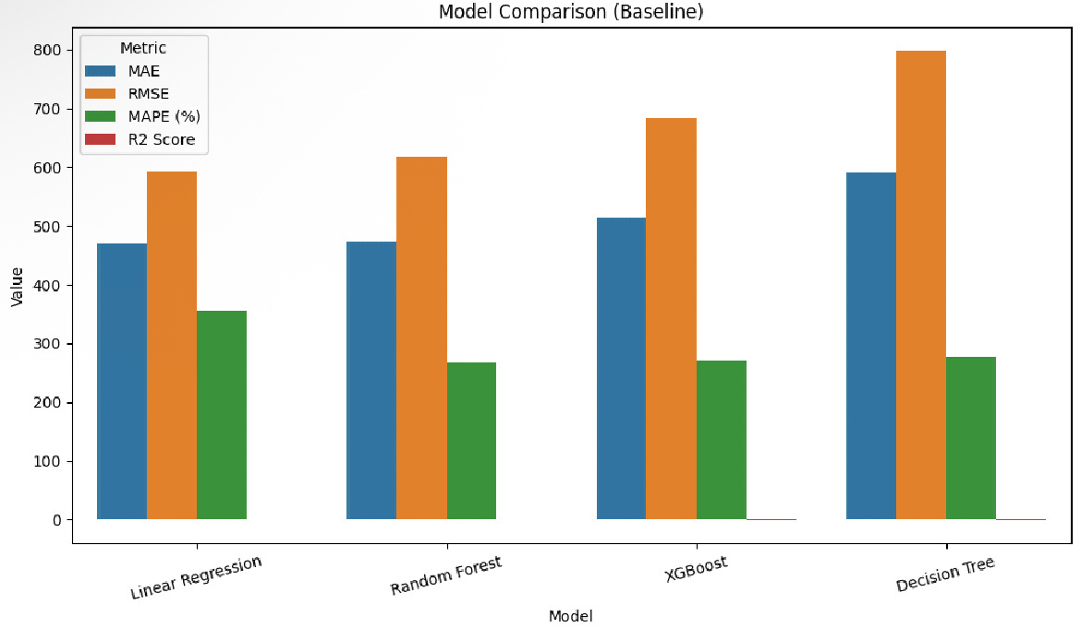

Slide 58
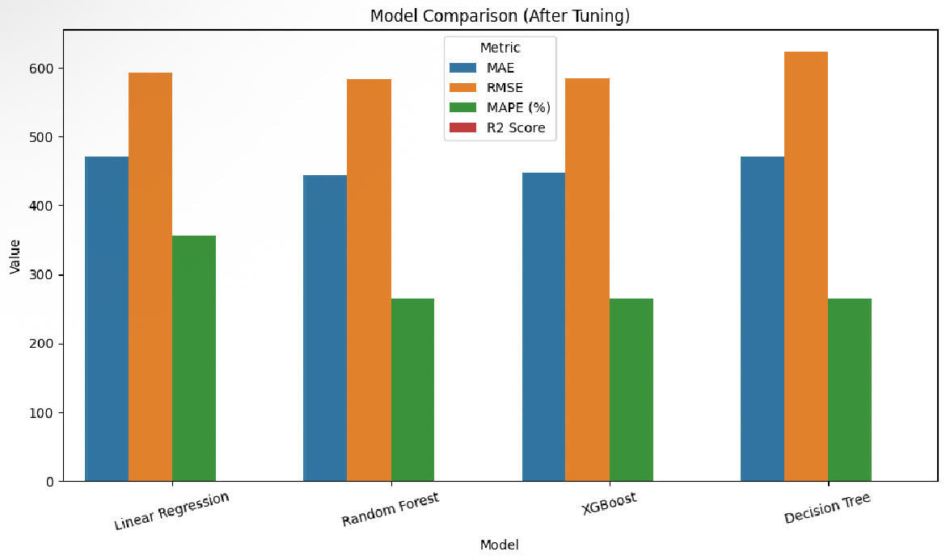

Slide 59
Insights
In this project, we conducted a comprehensive analysis of sales data to uncover valuable business insights. Through exploratory data analysis, we identified key sales drivers across regions, segments, and time. We addressed data quality issues, engineered predictive features, and developed time-series models to forecast sales.
Among all models, XGBoost proved the most effective, delivering superior accuracy and consistency. Insights derived from model performance and business trends enabled targeted recommendations across marketing, operations, and inventory.
This end-to-end analysis lays the foundation for smarter decision-making and scalable growth strategies.

Slide 60
Model Deployment
The best-performing model (XGBoost) was deployed using Streamlit.
The app allows users to interact with the model and make predictions in real-time.
Access the app online here:
A simple and interactive web application was built to allow users to test the model with real inputs.

Slide 61


Q&A Session

Slide 62
Thank You

